Slide 1
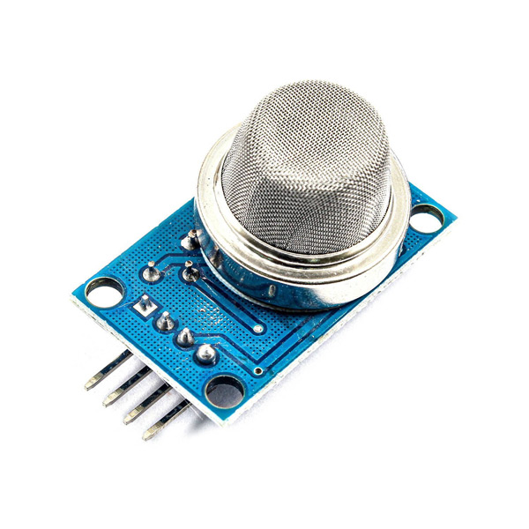

Slide 2
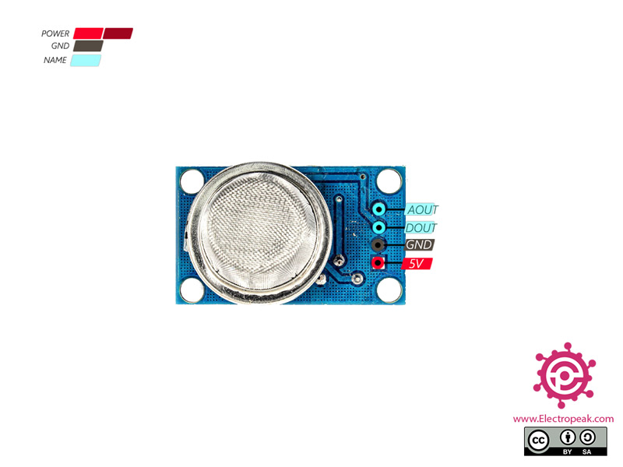
This sensor has 4 pins:
5V: Module power supply – 5 V
GND: Ground
DOUT: Digital output
AOUT: Analog output

Slide 3
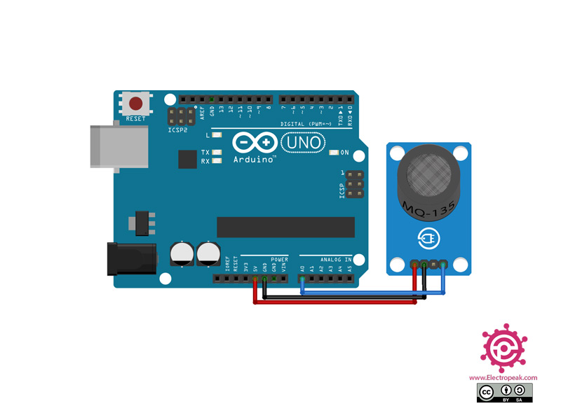

Slide 4
// the setup routine runs once when you press reset: void setup() { // initialize serial communication at 9600 bits per second: Serial.begin(9600); } // the loop routine runs over and over again forever: void loop() { // read the input on analog pin 0: int sensorValue = analogRead(A0); // print out the value you read: Serial.println(sensorValue); delay(20); }

